Slide 1
Kennedy and His New Frontier

Slide 2
The Election of 1960
Richard Milhouse Nixon ran against John F. Kennedy.
These two candidates were about as different as any two people could be.

Slide 3
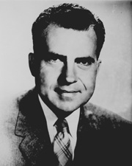
Richard Nixon
Nixon was a young candidate.
He came from a poor family.
Believed communism was America’s worst enemy.
Nixon was a very good radio debater, but people who watched the debates on T.V. thought Kennedy won because he was attractive.

Slide 4
John F. Kennedy
A very young candidate.
Came from a very rich family.
Believed communism was America’s worst enemy.
Good television speaker and due to his good looks many believed he would win the election.
Kennedy won the election by one of the smallest margins in history.

Slide 5
Kennedy’s “New Frontier”
This was an extension of FDR’s New Deal and Truman’s Fair Deal.
Kennedy will quickly be at odds with business leaders in the United States, especially in steel.

Slide 6
The Peace Corps
A volunteer program run by the US government to provide social and economic development abroad while promoting mutual understanding between Americans and populations served
Has affected:
way people of other countries view Americans
how Americans view other countries,
how Americans view their own country

Slide 7
Turn and Talk:
How could this organization play into the policy of containment?

Slide 8
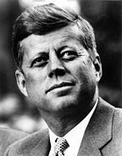
Other “New Frontier” Ideas
Kennedy went to work on funding public schools by passing new bills.
He tried fighting poverty in the South and in big cities.
He supported the Area Development Act which encouraged businesses to move into economically depressed areas.
The Housing Act asked for $5 billion for urban renewal

Slide 9
NASA
One of Kennedy’s biggest accomplishments was the National Aeronautics and Space Administration (NASA).
Part of this reason was to compete with the Soviets in the Cold War.

Slide 10
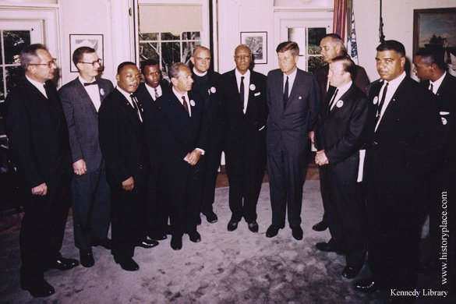
Kennedy at Odds
Kennedy was frequently at odds with the legislative branch.
Southern senators and representatives blocked many of the measures that he tried to pass partly because he was for civil rights.

Slide 11
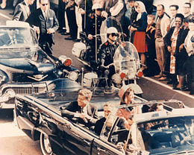
Kennedy’s Death
When Kennedy went to Dallas to try and stir up support for his programs, he was assassinated on November 22, 1963.
When he was killed, it seemed as if time stopped in this country.
This also affected people around the globe specifically allies that Kennedy had made in many third world countries.

Slide 12
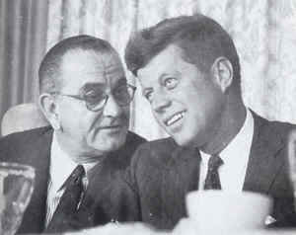
Lyndon B. Johnson
Lyndon B. Johnson would take over for Kennedy.
Only 5 days after Kennedy’s death, Johnson made a speech to the American public saying he would continue on with JFK’s plans.
He came up with a new term for the new America called the Great Society.

Slide 13
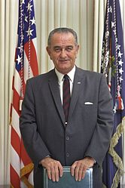
The Great Society
Johnson tried to fight poverty, pollution, unemployment, discrimination, and everything else that was wrong with this country.
To fight poverty and unemployment, Johnson launched the Office of Economic Opportunity

Slide 14
Office of Economic Opportunity
This organization sent workers to poor neighborhoods to help people get back on their feet.
Job Corps, Project Head Start, and the Elementary and Secondary Education Act were all examples of Johnson’s war on poverty.

Slide 15
More Johnson Programs
Johnson passed the Medicare Act through Congress.
He responded to immigration by passing the Immigration Act which allowed more people from the far east and deleted the national quota system.

Slide 16
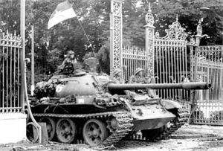
Government Spending
Even with all the good things Johnson was attempting to do, his government spending was out of hand.
The Vietnam War was part of the problem because it was eating up $20 billion a year.

Slide 17
1960’s: An Important Time
During Johnson presidency, the American public had become deeply divided.
We had seen the emergence of the youth during this time, but we also saw three of the most important young people killed (JFK, Martin Luther King Jr., and Robert Kennedy)
Division would continue into Nixon’s presidency.

